Slide 1
Traffic Has
Shape
“The purpose of computing is insight, not numbers.”
— Richard Hamming

Slide 2
Same link. Same load. Different queue.
smooth
bursty
P99 queueing delay
0.12 ms → 14.5 ms
packets dropped
0 → 10,650
100 Mbps link · 80 Mbps mean load · identical topology.
Traffic Has Shape
02 / 36

Slide 3
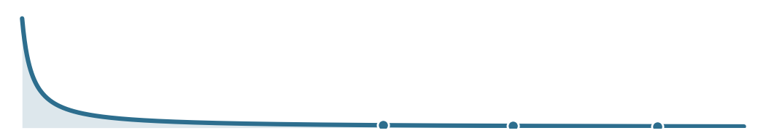
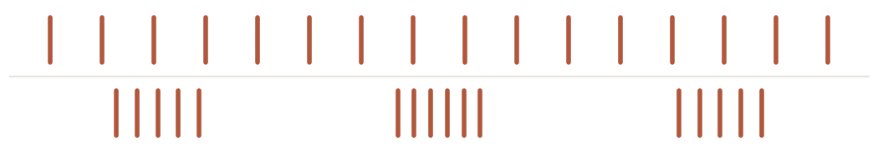
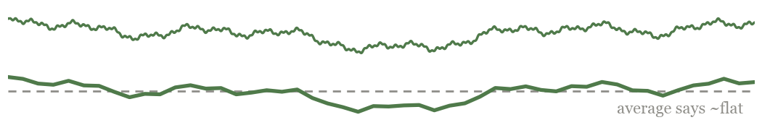
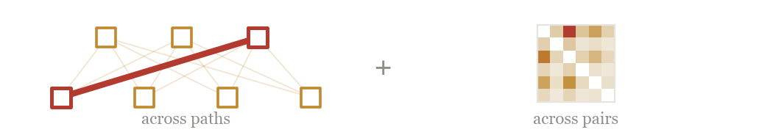
Four ways the same traffic
can behave differently.
SIZE
ARRIVAL
How big are the flows?
Do they arrive smoothly or together?
TIME-SCALE
SPATIAL
Does the pattern survive aggregation?
Where does the traffic land?
Traffic Has Shape
04 / 36

Slide 4
AXIS 1 OF 4
Size shape.
Traffic Has Shape
06 / 36

Slide 5
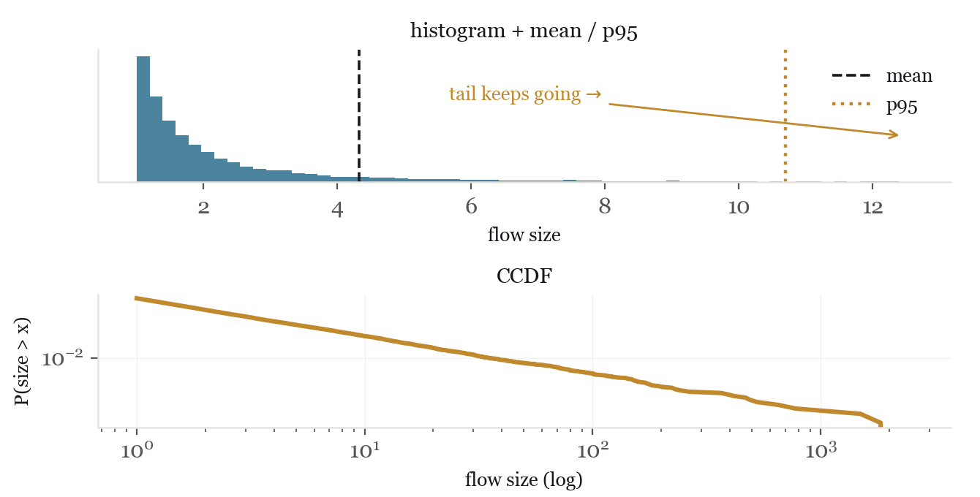
The tail is often where network behavior changes.
We read the mean and p95, two points. The distribution is the whole shape, and for traffic the tail is where the bytes are.
• Distribution: how often each size shows up.
• Light tail: extremes are rare and small (bell curve).
• Heavy tail: rare giant flows dominate the bytes.
• CCDF = P(size > x): reads the tail directly.
Traffic Has Shape
07 / 36

Slide 6
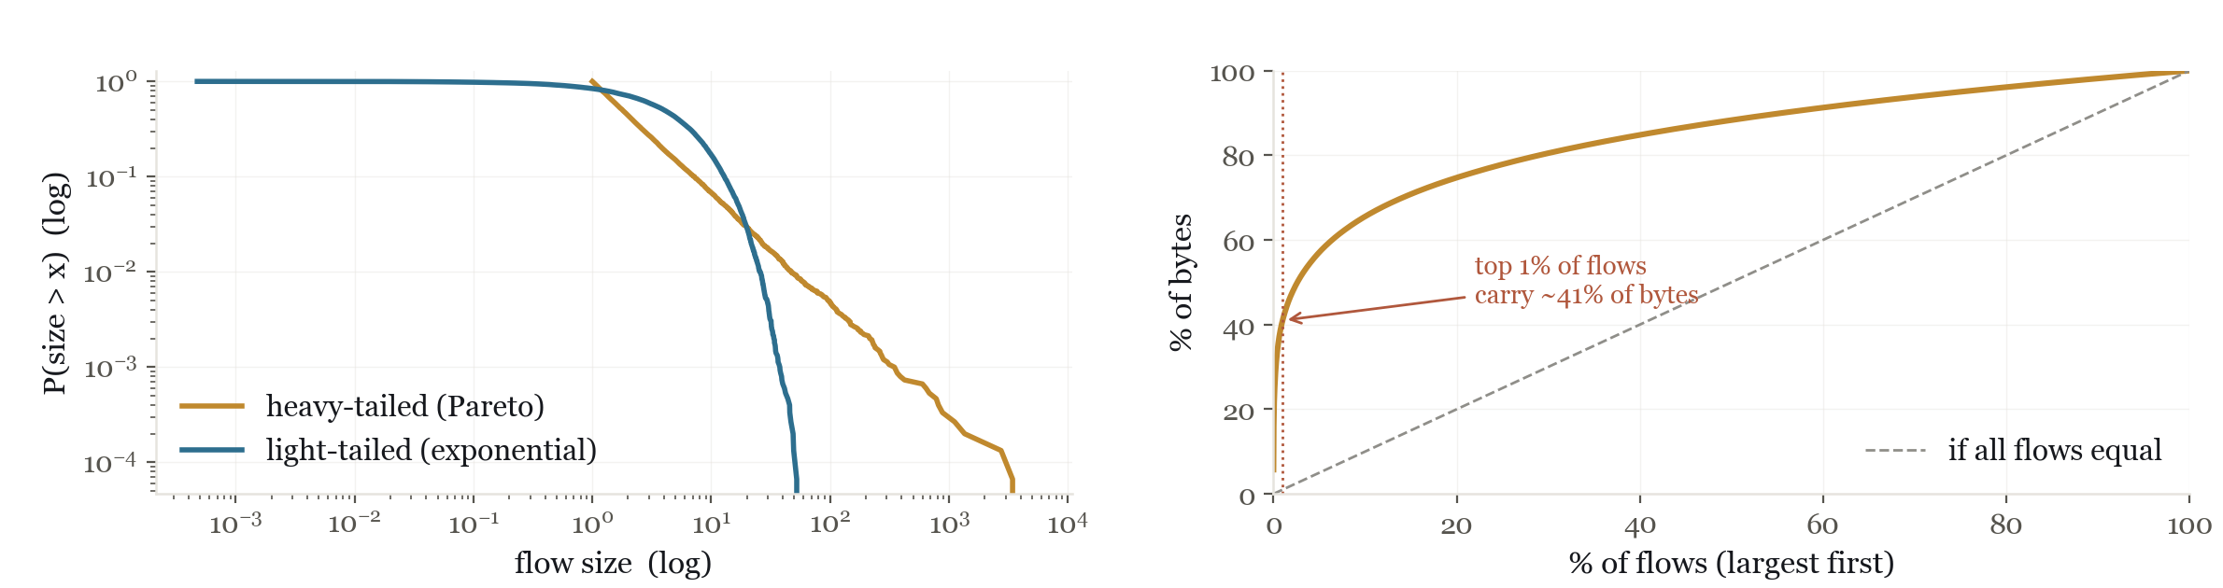
Look beyond the typical value.
When sizes are heavy-tailed, the tail is where the bytes are.
Traffic Has Shape
08 / 36

Slide 7
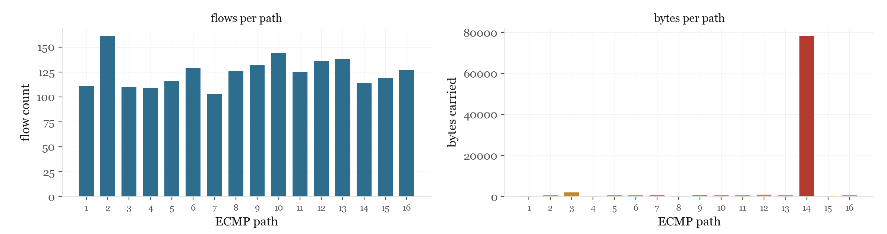
Flow count and byte load can tell different stories.
ECMP spreads flow IDs. It does not spread bytes evenly.
Traffic Has Shape
09 / 36

Slide 8
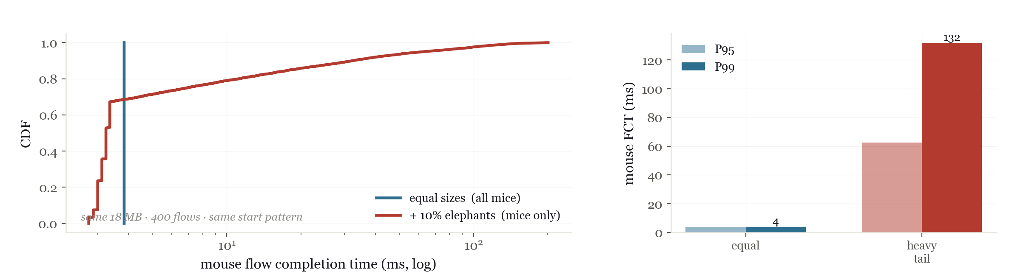
A few elephants move
the mice tail.
Same total bytes, same 400 flows, same start pattern, same link. Only the size distribution changes. Equal sizes finish fast. When bytes concentrate into a few elephants, the small-flow tail blows out.
Traffic Has Shape
10 / 36

Slide 9
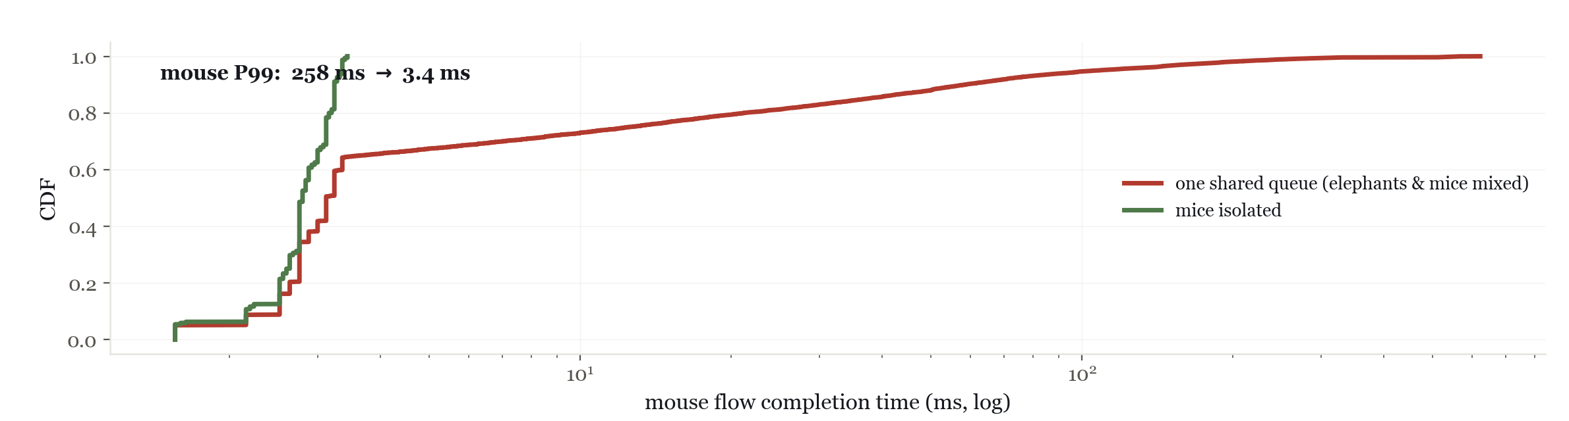
Once we know the shape, we have options.
Same heavy-tailed workload, two policies: one shared queue vs isolating the short flows (mouse-priority scheduling). No extra capacity, just a size-aware queue.
Traffic Has Shape
11 / 36

Slide 10
AXIS 2 OF 4
Arrival shape.
Traffic Has Shape
12 / 36

Slide 11
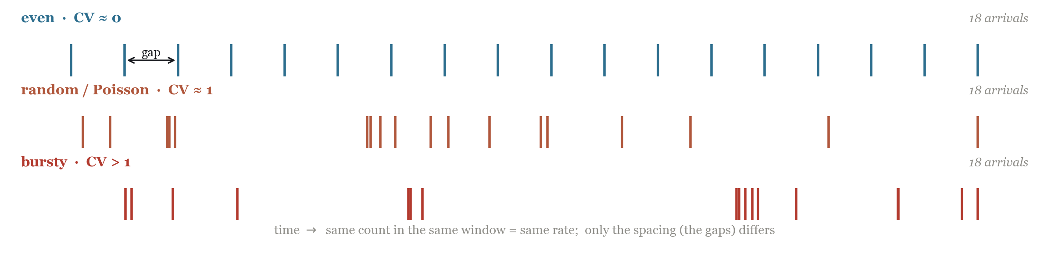
Rate says how much. The gaps say when.
One number scores the spacing, the CV of the gaps: 0 even · 1 random · >1 bursty. At a fixed mean load, CV tells us what the rate hides.
Traffic Has Shape
13 / 36

Slide 12
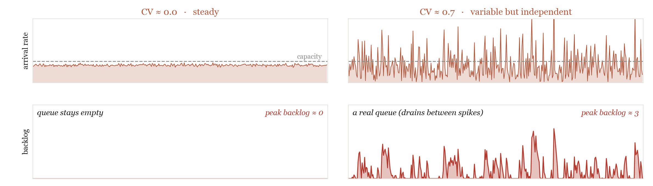
Variable arrivals build a queue.
Variability alone builds a queue. These spikes can still drain between bursts.
Traffic Has Shape
14 / 36

Slide 13
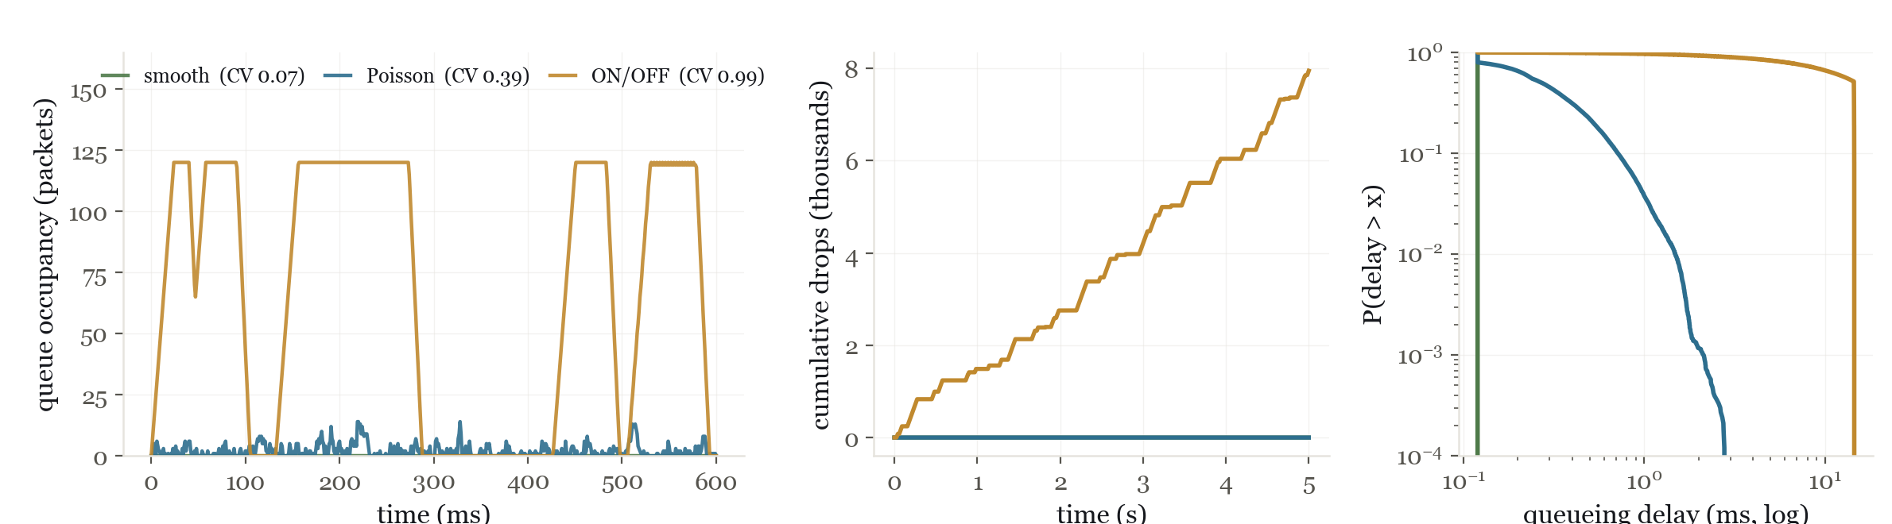
Burstier arrivals overflow the buffer.
One 100 Mbps queue, 120-packet buffer, 80 Mbps offered. Only the arrival CV changes.
Traffic Has Shape
15 / 36

Slide 14
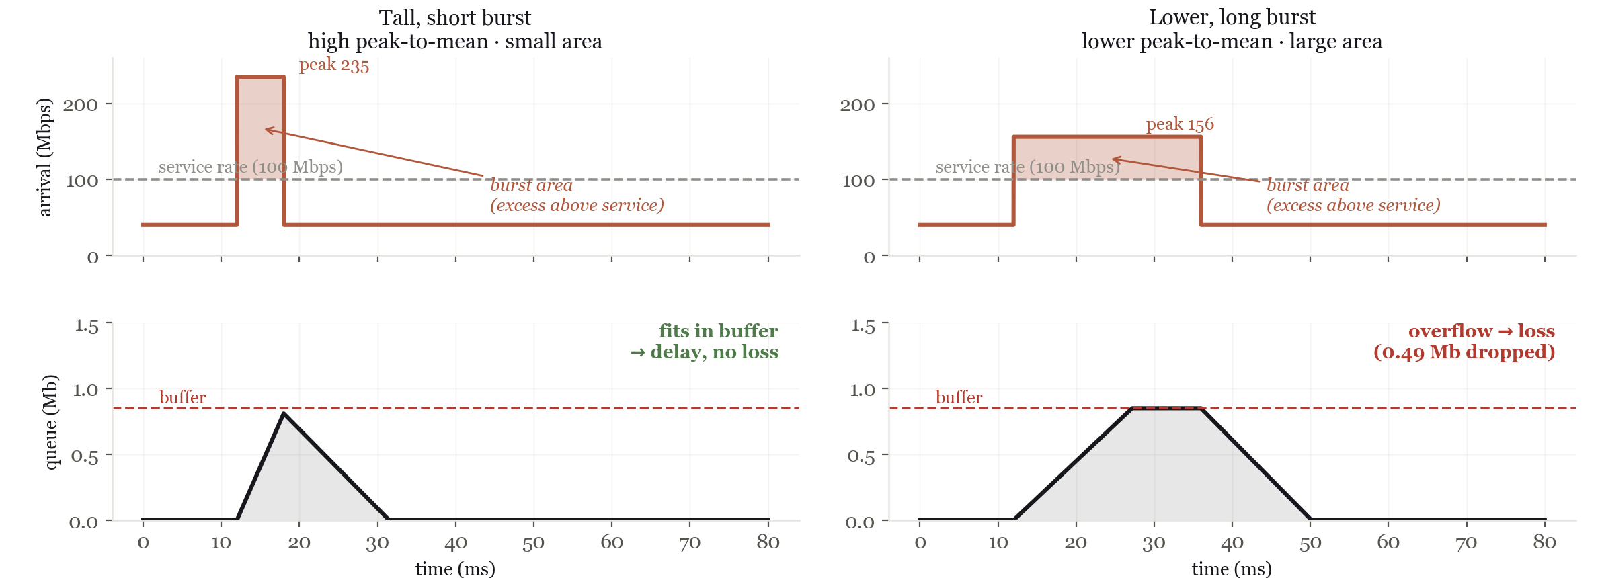
The queue integrates the burst.
What costs you is the AREA above service: height × duration. A tall, short burst (left) drains; a lower, long burst (right) holds more area and overflows into loss.
Traffic Has Shape
16 / 36

Slide 15
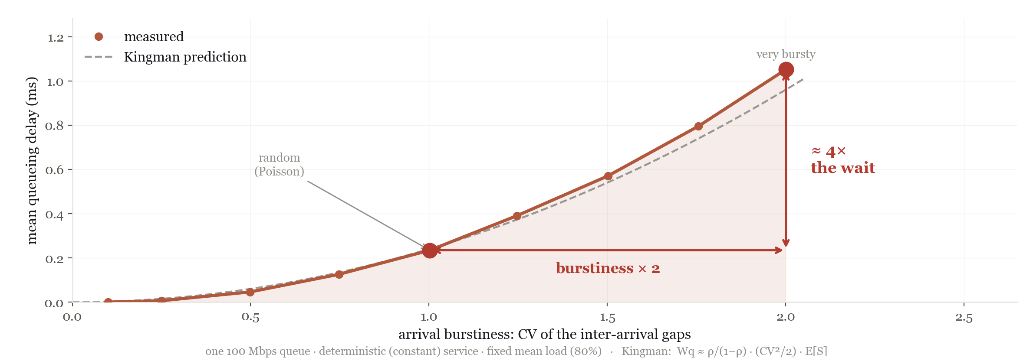
More burstiness, much more waiting.
Kingman intuition: waiting grows roughly with CV².
Traffic Has Shape
17 / 36

Slide 16
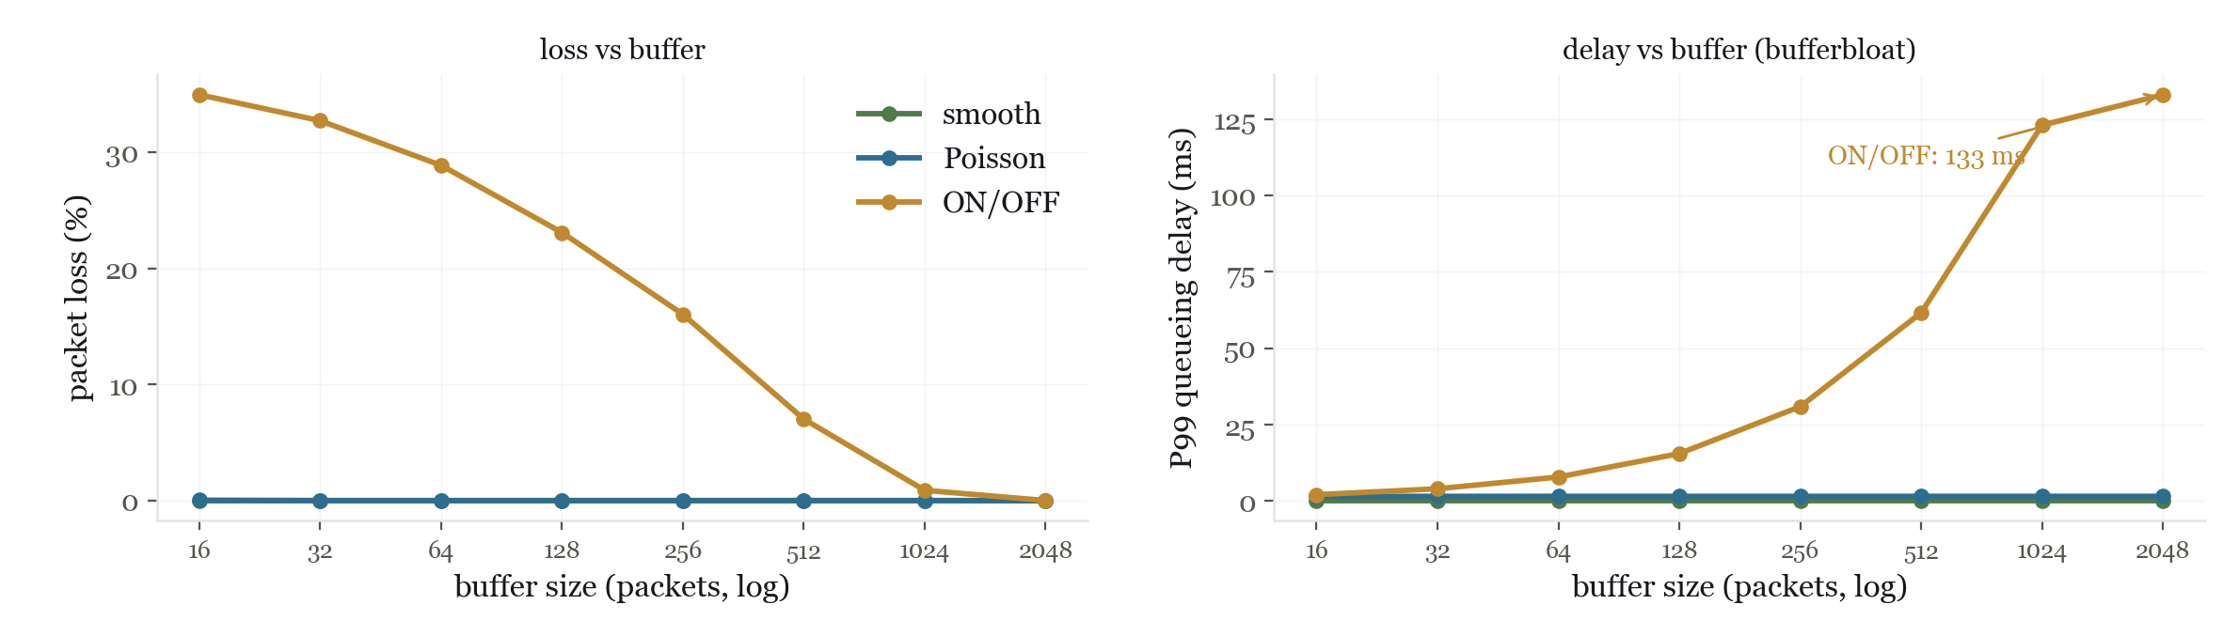
Buffers change the tradeoff; they don't remove burstiness.
Bursty traffic only trades loss for delay. The fix isn't more buffer; it's managing the shape: pacing, AQM/ECN, admission, isolation.
Traffic Has Shape
18 / 36

Slide 17
AXIS 3 OF 4
Time-scale shape.
Traffic Has Shape
19 / 36

Slide 18
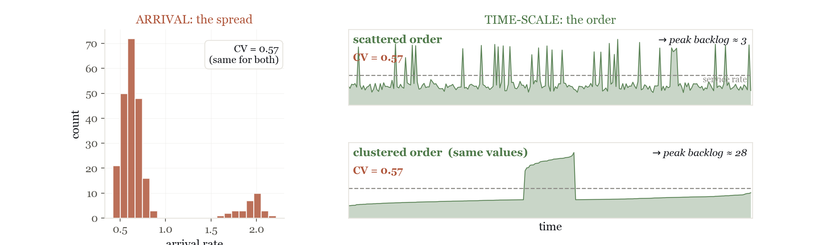
The order is what built the queue.
Identical values, reordered: cluster the highs and the queue explodes.
Traffic Has Shape
20 / 36

Slide 19
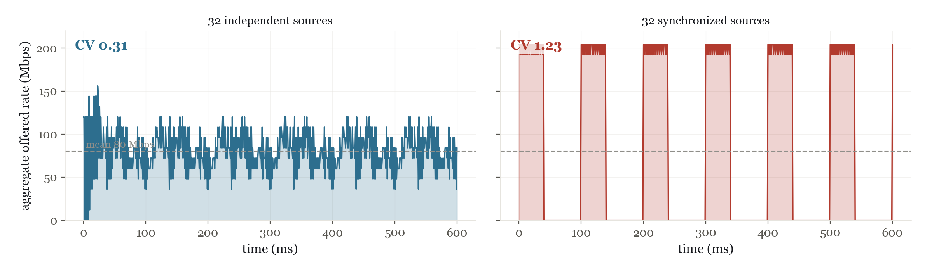
Correlation turns safe sources into one burst.
Independent, the bursts cancel out. Aligned, they become one big burst: cron jobs, retry storms, synced timeouts.
Traffic Has Shape
21 / 36

Slide 20
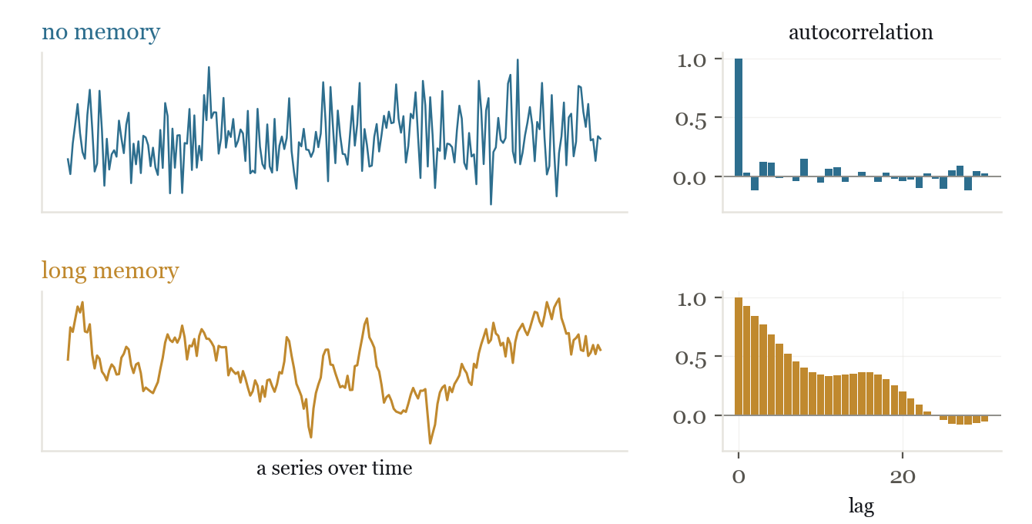
First: does traffic remember its past?
The question: when one moment is high, is the next one high too?
• Autocorrelation: compare a series to its own recent past.
• No memory: each moment is independent, so the ACF drops to 0 fast.
• Long memory: highs follow highs, so the ACF decays slowly.
Traffic Has Shape
22 / 36

Slide 21
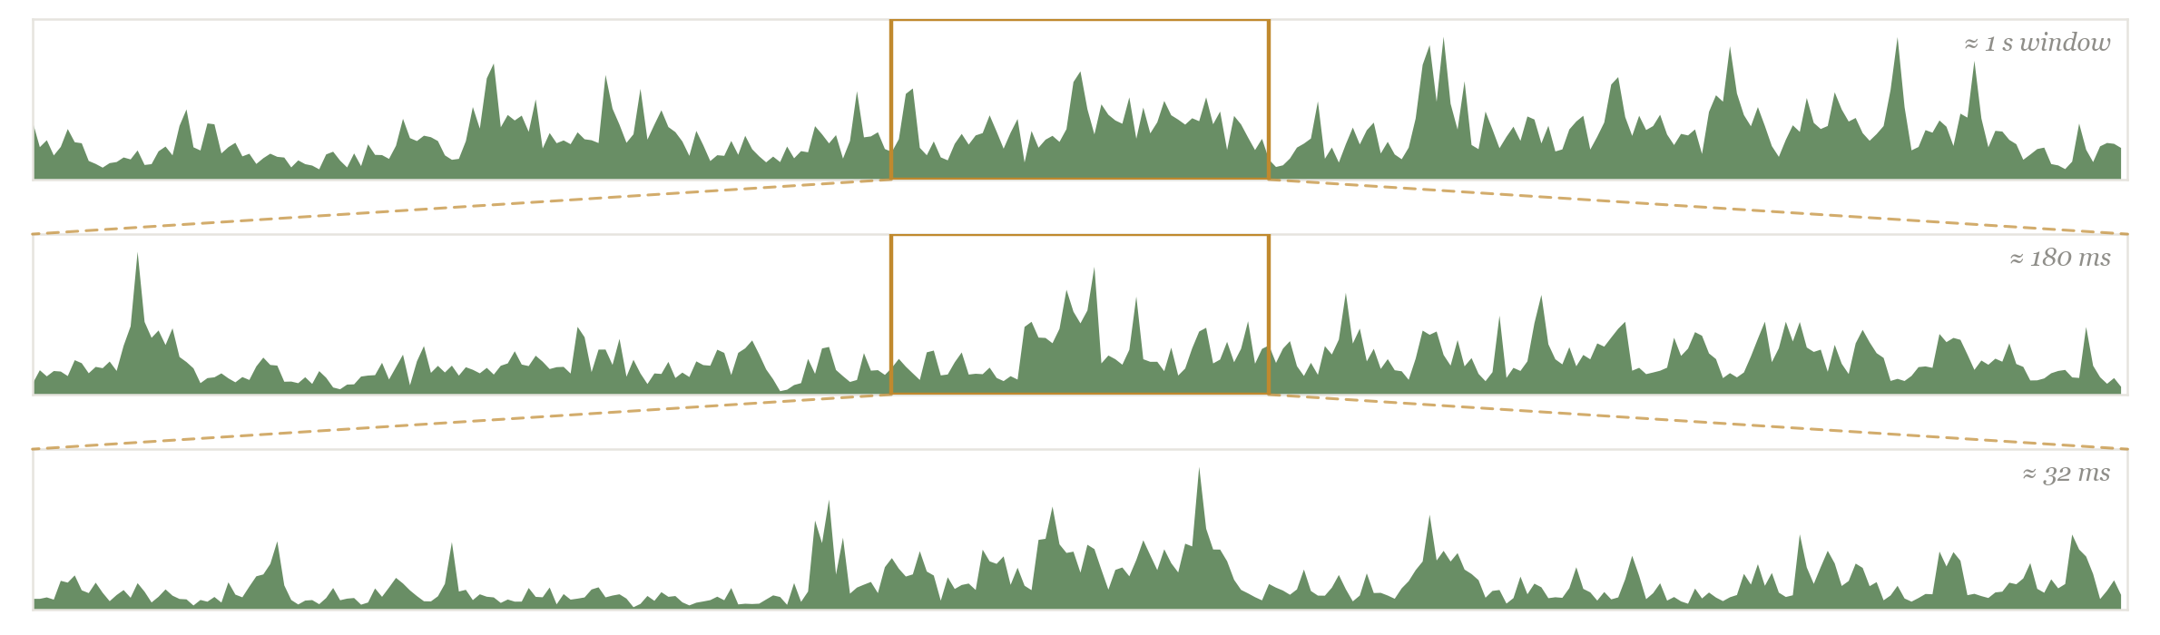
Self-similar: bursts within bursts.
Zoom into any burst and there are more bursts inside, at every scale.
Traffic Has Shape
23 / 36

Slide 22
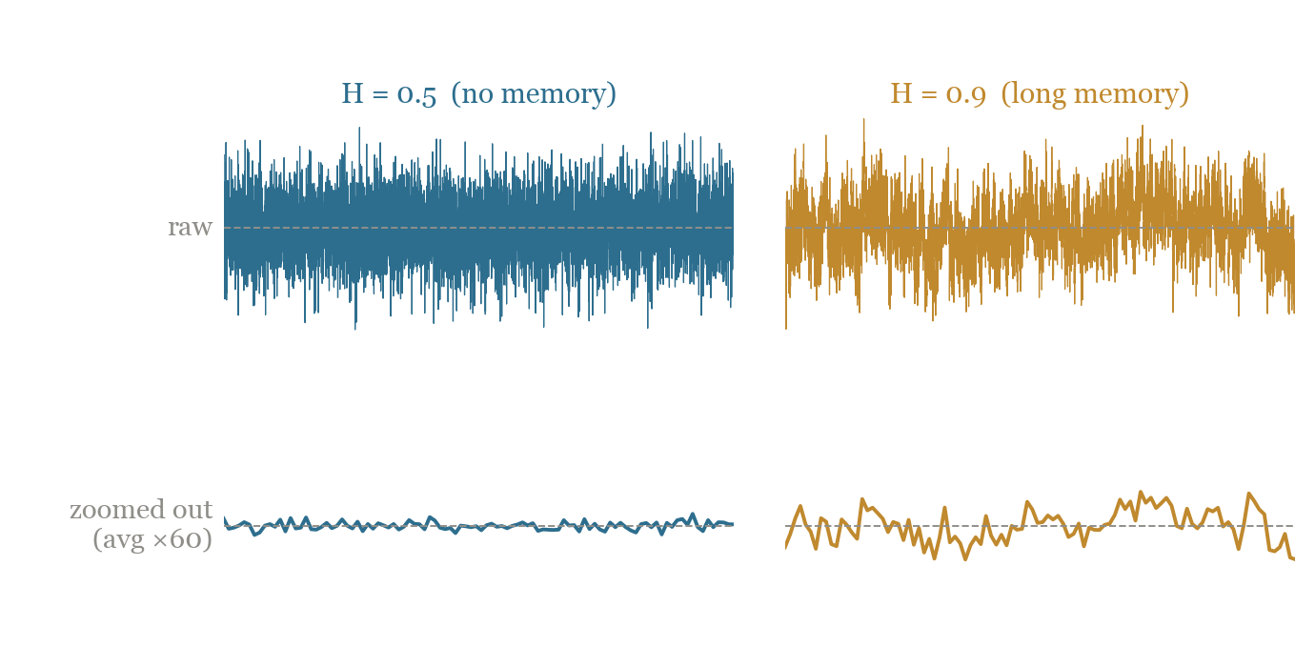
Hurst: how much burstiness survives the zoom.
Average over a wider window: short bursts blur away, long ones survive. Low H smooths to flat; high H stays bursty at every zoom.
• H = 0.5: no memory, just random noise; any window averages it to the mean.
• 0.5 < H < 1: long swings outlast the window, so burstiness survives the zoom.
• H → 1: bursts at every scale, no window ever smooths it.
• Measured from how slowly variance falls as you widen the window.
Traffic Has Shape
24 / 36

Slide 23
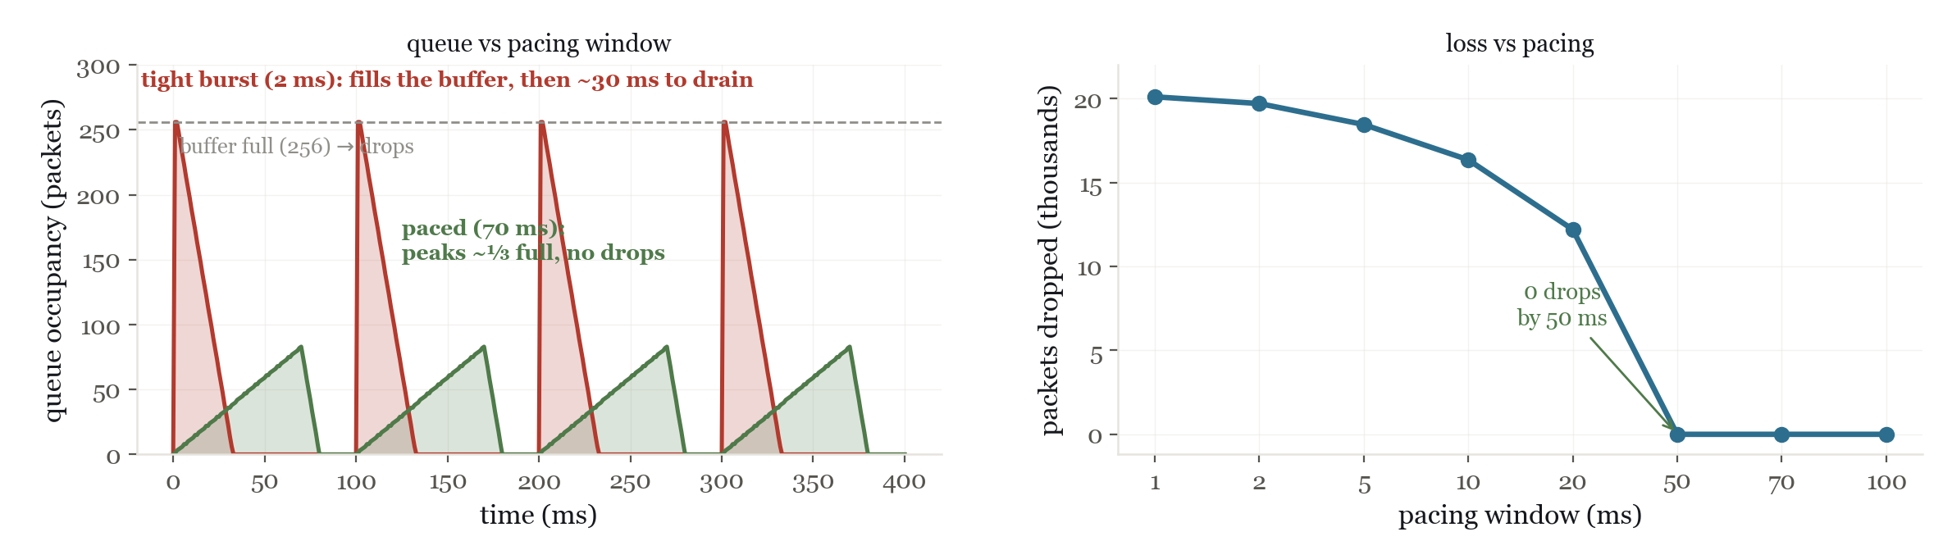
Pace the burst, and the queue clears.
Spread the same burst out in time: no drops, and the queue stays small.
Traffic Has Shape
26 / 36

Slide 24
AXIS 4 OF 4
Spatial shape.
Traffic Has Shape
27 / 36

Slide 25
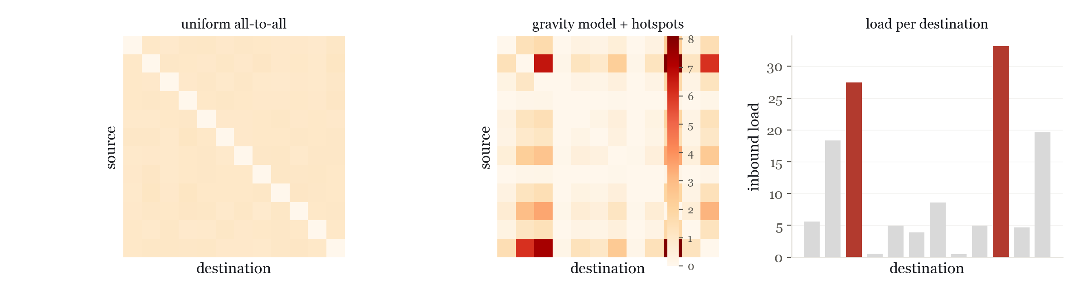
Read the traffic matrix.
Topology is supply; the traffic matrix is demand. model: pipe, gravity, or hose.
Traffic Has Shape
28 / 36

Slide 26
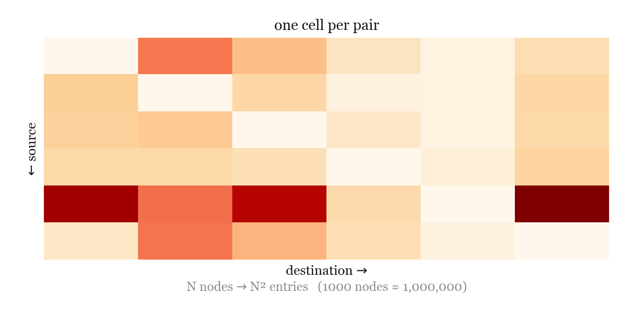
Pipe model: specify every pair.
Name the demand for every source→destination pair: ground truth, but expensive to get and quick to go stale.
• One number per ordered pair: the complete origin→destination table.
• Exact: nothing is assumed or averaged.
• But N² entries (≈1M for 1000 nodes), and it shifts constantly.
• We can rarely measure all of it directly.
Traffic Has Shape
29 / 36

Slide 27
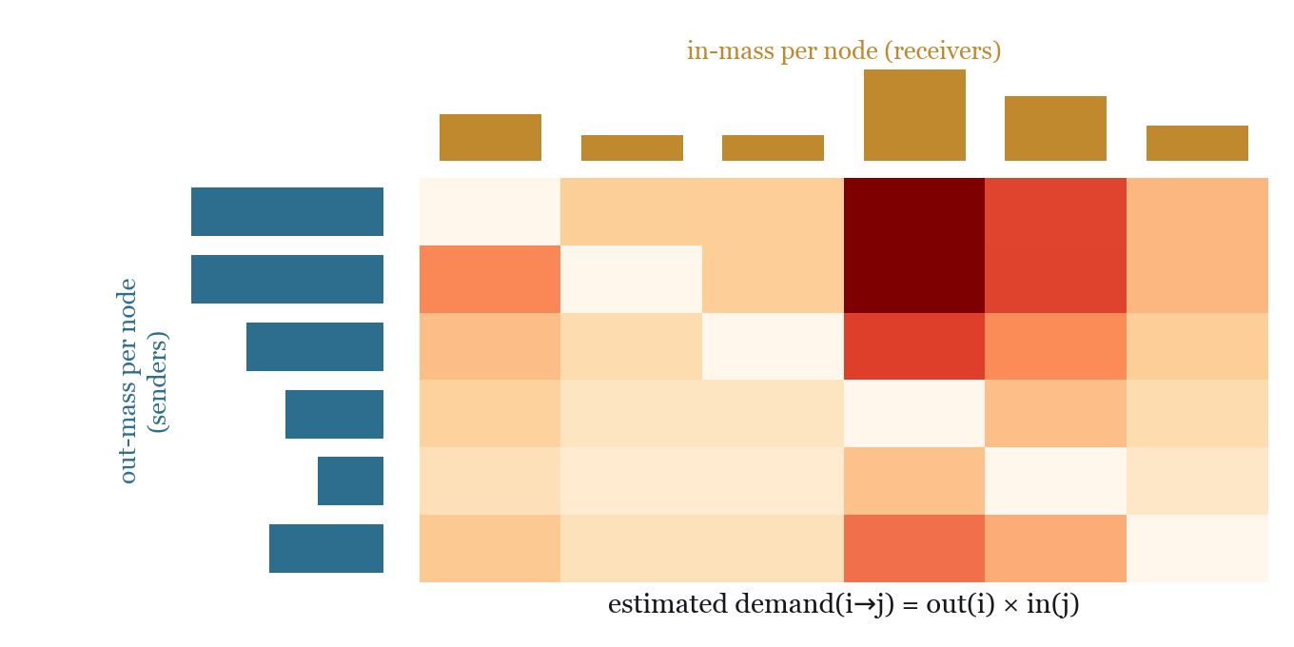
Gravity model: infer pairs from send/receive totals.
We CAN measure how much each node sends and receives. Gravity fills in the pairs from just those.
• demand(i→j) ∝ out(i) × in(j): big senders × big receivers.
• Like gravity / trade between cities by size.
• Needs only 2N totals (interface counters), not N².
• Tomogravity adds link-load counts to sharpen it.
Traffic Has Shape
30 / 36

Slide 28
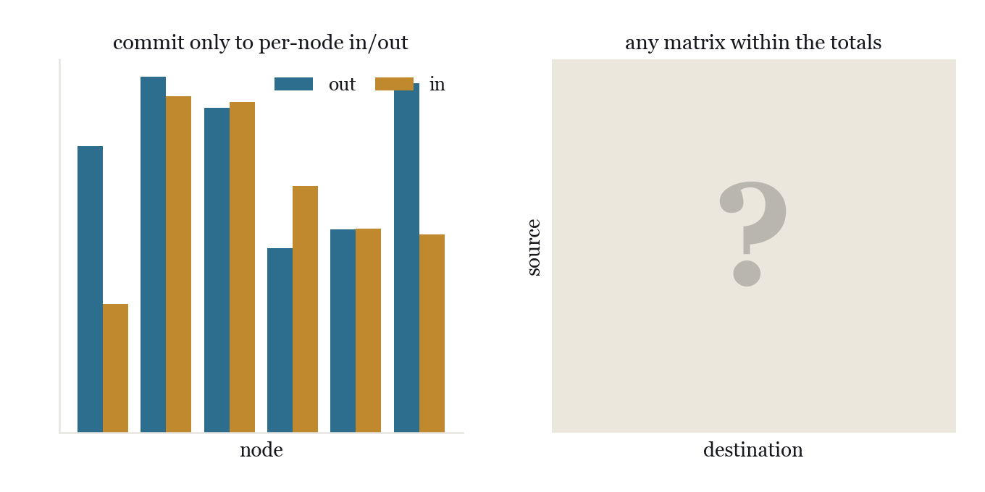
Hose: bound the node, not the matrix.
Don't model the matrix at all: commit only to each node's total in and out. Best when the matrix won't hold still.
• Per node: ≤ X out, ≤ Y in, like a water hose's flow rate.
• The network must handle ANY matrix within those limits.
• Robust when the matrix is unknown or shifts (VPNs, multi-tenant).
• Trades some capacity efficiency for robustness.
Traffic Has Shape
31 / 36

Slide 29
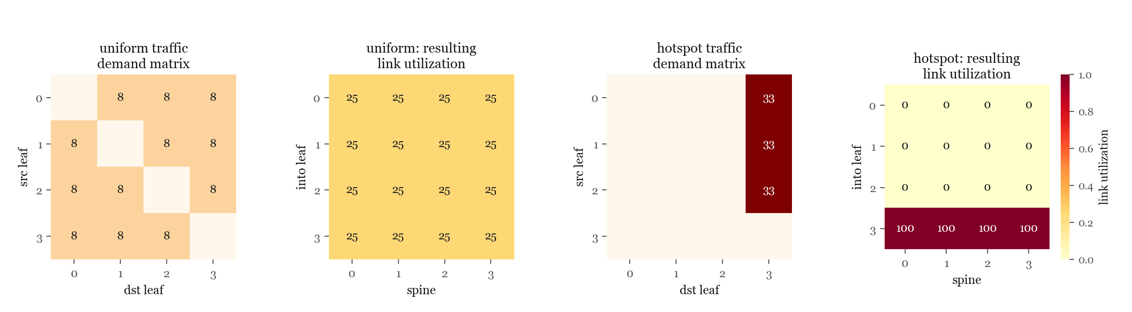
Capacity has location.
Route the same 100 units over a leaf / spine fabric. Spread it evenly and every link sits at 25%; aim it many-to-one and one leaf saturates while the rest sit idle. Same demand, different destination, different bottleneck.
Traffic Has Shape
32 / 36

Slide 30
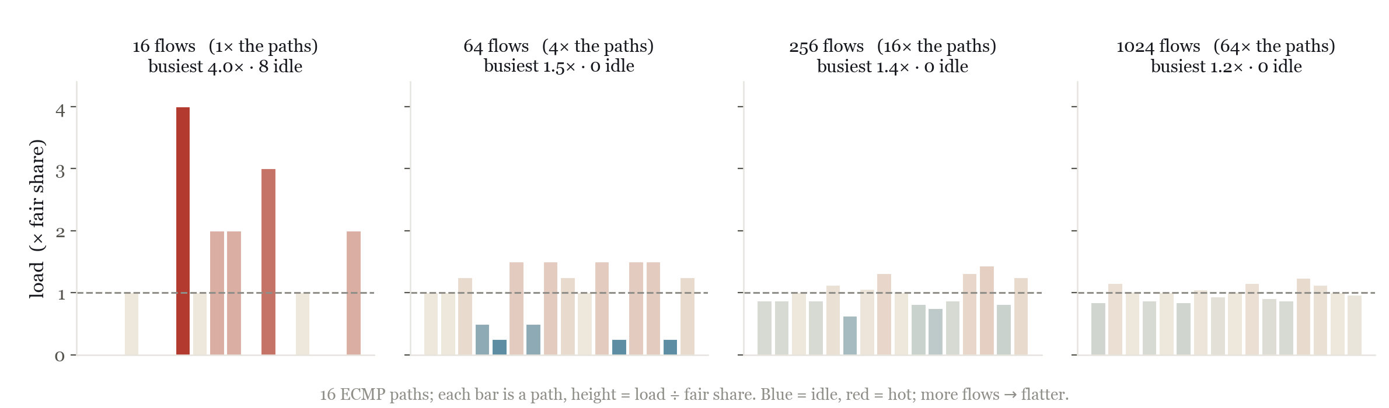
ECMP needs many flows per path.
At flows ≈ paths, one path runs ~4× hot; ECMP only balances when flows ≫ paths.
Traffic Has Shape
33 / 36

Slide 31
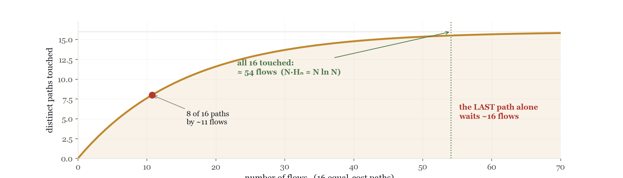
Coupon collector: the last paths fill slowest.
Half the paths fill by ~11 flows; all 16 take ~54. Few flows on many paths means idle links beside a hot one.
Traffic Has Shape
34 / 36

Slide 32
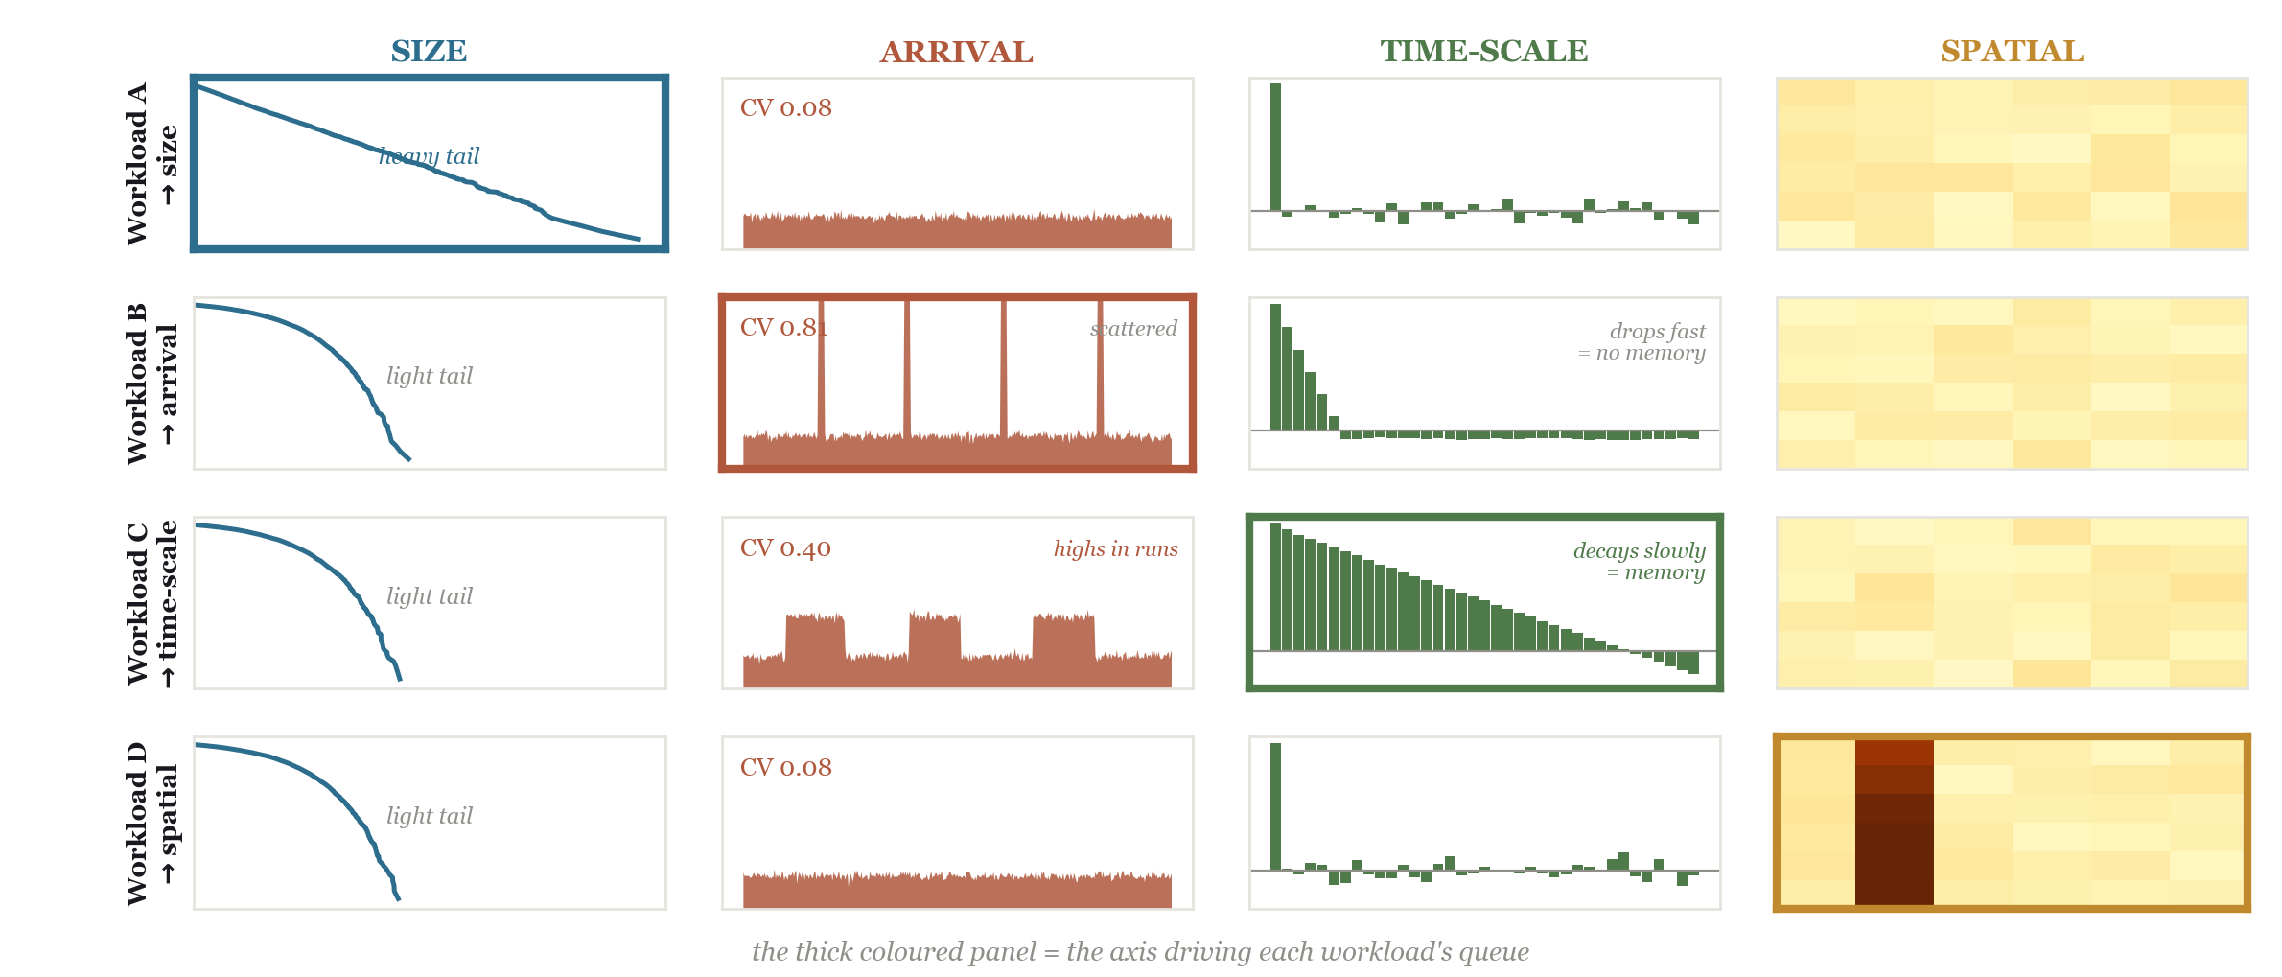
Different failures, different fingerprints.
Traffic Has Shape
35 / 36

Slide 33
The number is one view.
The shape is another.
distribution · timing · memory · location
Traffic Has Shape
36 / 36

